Slide 1


Analysis of Cryptocurrencies
By - Vineet Kapoor(11910076)
ISB CBA Practicum
28th June , 2018

Slide 2


Slide 3
Table Of Contents
Executive Summary
Business Problem
Introduction
Motivation For Study
Methodology & Tools
Models
Message
Means
Analytics Approach
Connecting CBA Term – 1 courses
Data collection & cleaning
Data Understanding
Data Preparation
Analysis & Results

Slide 4
Data Preparation
Data Understanding
Modelling & Evaluation
Business Recommendation
Assumptions, Limitations.
References.

Slide 5
Executive Summary
Overall Sentiments of cryptocurrency is Neutral and then, positive. Sentiments in US and India follow similar pattern.
Growth of cryptocurrency market is on downside as per the analysis. The forecast is best for Bitcoin cash.
Development in Blockchain is the main factor for the growth in cryptocurrency, ICO. They influence the sentiments of stakeholders.
Overall sentiment is neutral among financial institutions, experts, investors, public.

Slide 6
Business Problem
Analyse the sentiments for cryptocurrency in general and compare the sentiments and prices across the cryptocurrencies.
Analyse the articles, opinions, researches and understand the perspective of different stakeholders‐ regulators, exchanges, financial institutions, experts, investors and public.
Identify the factors that are driving the market and influencing the stakeholders. Analyse the growth of cryptocurrency market‐ overall and regional level

Slide 7
Introduction
Cryptocurrencies are distributed digital assets , in which currency is not held in digital form. It allows for speedy transactions between different parties.
Cryptocurrency is not a crypto coin , it is a name given to cryptographic accounting unit. Financial transactions in these units are secured by cryptography.
The most famous cryptocurrency – Bitcoin emerged after 2008 global monetary crisis.
Many cryptocurrencies have been launched after bitcoin and few countries have already legalised the cryptocurrencies such as
The sentiments related to cryptocurrencies need to be reviewed from twitter tweets and articles can be used to analyse the future growth and important factors in the growth of cryptocurrencies.

Slide 8
Motivation For Study
The Analysis of Twitter tweets from user timeline and live streaming of hashtags can be used to predict the sentiments of new tweets or articles.
I have tried to find the factors impacting the growth of cryptocurrencies among regulators, exchangers, financial institutions and users.
In today’s information, the tweets can be used by investors to predict the growth of cryptocurrencies.

Slide 9
Methodology and Tools
The Data has been taken from twitter using twitter API and various news articles, blogs.
The data has also been taken from coinmarketcap.com.
Historical prices of top 4 currencies have been scraped. BeautifulSoup and Selenium is used in python and twitter package was used in R programming for taking live streaming tweets and rest tweets.
Tableau has also been used to visualise the forecast and trend of top 4 cryptocurrencies.
For hypothesis testing and sentiment classifier model from articles, blogs, Python has been used. For sentiment analysis on twitter data and classifier model, R has been used.

Slide 10
Analytic Approach
Perform ANOVA Hypothesis testing between top four cryptocurrencies to determine if the average daily returns are equal or not.
To analyse the cryptocurrency, which is best to invest with minimum risk.
Check for correlation between different cryptocurrencies.
Check for factors responsible for predicting cryptocurrencies growth.
To analyse growth of cryptocurrency worldwide and regional wise.
To build a classifier model to predict sentiments of tweets from twitter regarding cryptocurrency.
To build a classifier model to predict sentiments of documents from news articles.
Analyse the sentiments of investors, regulators, financial institutions and banks

Slide 11
Models
Anova Hypothesis testing is used to compare the average daily returns of different four cryptocurrencies.
F – test is used to find out the currency , which is best to invest considering risk and returns.
Naïve Bayes model is used on textual data from articles and blogs in Python.
Max entropy model is used on twitter tweets for prediction of sentiments from tweets in R programming.

Slide 12
Questions & Hypothesis
Following are some of the key questions/ hypothesis that we would like to answer/ test:
Perform ANOVA Hypothesis testing between top four cryptocurrencies to determine if the average daily returns are equal or not.
Correlation coefficient between top four cryptocurrencies.
Test the compounded polarity score of the views of investors and financial banks regarding cryptocurrency.

Slide 13
Message
Blockchain is the factor responsible for Cryptocurrencies growth and decline.
Ethereum is the currency, which can be used for investment, as it’s average daily returns are better than other three cryptocurrencies – Bitcoin, Bitcoin – cash, ripple.
The pattern of twitter sentiments is similar in US and India, the pattern is like overall sentiment. Japan has a different pattern of sentiments.
Bitcoin is the currency used for most of the transactions.
There is high correlation between bitcoin and Ethereum close price.
The forecast of close price of Bitcoin and Ripple shows that the prices will decline.
Proportion of neutral and positive sentiments from news articles and blogs are almost similar and greater than negative sentiments.

Slide 14
Means
Visualization Tools - Tableau, Python, R.
Collection Tools – R, python.
Modelling Tools – Naïve Bayes and Max Entropy model.
Libraries used – in R: twitter, SnowballC, syuzhet, tm, ROAuth, dplyr, magrittr, ggplot2, wordcloud, stringr, udpipe, textrank, igraph, ggraph, qdap, tidytext, tidyverse, sentiment, RColorBrewer.
In Python: nltk, numpy, pandas, tweepy, matplotlib, textblob, random, selenium webdriver, string, seaborn, datetime, scipy, beautifulsoup, requests

Slide 15
Connecting CBA Term – 1 courses
Statistical Analysis -1 has been used for ANOVA and F-test. Data collection course learning are applied for Web scraping. Text Analysis course modules are applied for Text cleaning, DTM, cluster and Text classification. Data Visualization course is used for making charts, wordclouds.

Slide 16
Data collection & cleaning
Twitter, news articles, blogs and coinmarketcap.com were predominantly used as data source for this study.
Tweets containing hashtags of “bitcoin”, “ethereum”, “blockchain” and “cryptocurrency” in twitter were used.
Tweets from @user time line of Bitcoin, Ethereum, Ripple, CryptoBoomNews and Blockchain were downloaded.
Cryptocurrency views data from news articles was scraped. From ….
The historical prices of bitcoin, Ethereum, bitcoincash and ripple were scraped from coinmarketcap website
The cryptocurrencies last 30days data was downloaded from coinmarketcap website.
Except the tweets from twitter and data from articles, the rest of the data was cleaned.

Slide 17
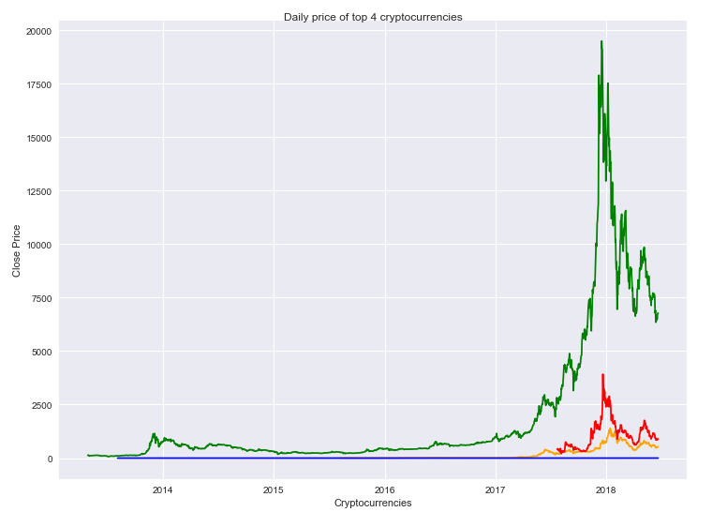
Data Understanding - Analysis & results: The below chart shows comparison of Close price. The green line in the chart corresponds to Bitcoin, red line shows the bitcoin cash, yellow line shows Ethereum. Blue line shows ripple. This chart shows that Bitcoin close price is very high relative to other currencies. At the end of 2017, it gained a lot.

Slide 18
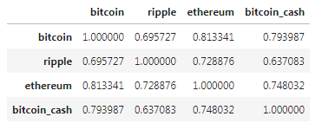
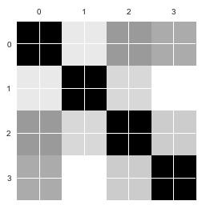
Correlation between top 4 cryptocurrencies. There is high correlation between bitcoin and ethereum.

Slide 19
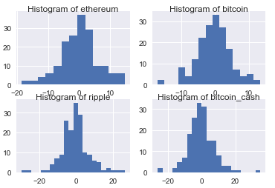
Histogram of close prices of all the four cryptocurrencies. All of them are following a standard normal curve

Slide 20
For Bitcoin, frequency of tweets is relatively higher in May month as compared to June month. 9.3260 is the average daily number of tweets

Slide 21
Only for one day, the frequency of Ethereum tweets saw an outlier, except that, the average frequency is 1.53 is the average daily number of tweets.

Slide 22
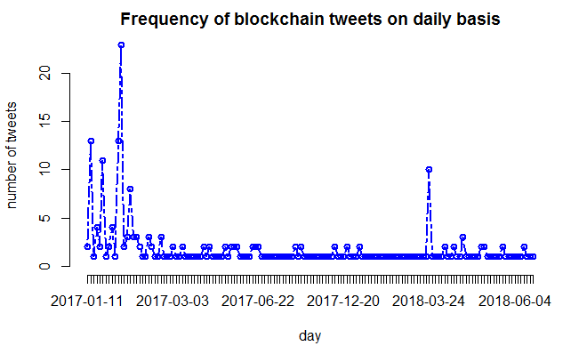
1.8 is the mean of frequency of blockchain tweets on every day. There are few outliers in January and February month.

Slide 23
Followers engagement with bitcoin is decreasing after first first week of June month. In may month, the number of followers were more than 200 many times as compared to June month. For last 30 days.

Slide 24
Followers engagement of Ethereum currency are is more at the end of the year 2017. The retweets have increased in 2018 relative to 2017.

Slide 25
Wordcloud of tweets from Bitcoin time line. Most of the words are related to money, block, transaction, system, video, network.

Slide 26
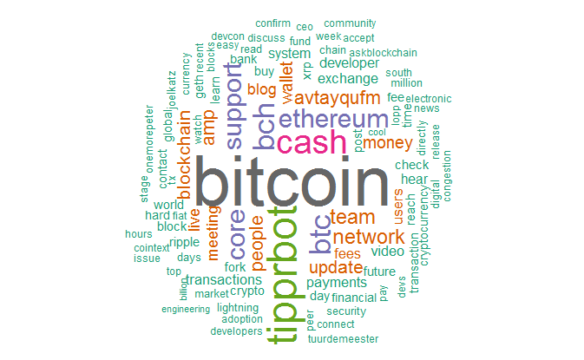
Wordcloud of ethereum, bitcoin, ripple corpus. Most of the words are same as occurred in previous wordcloud
Wordcloud of common tokens in Cryptocurrency user time line corpus. High frequency occurring words are bitcoin, Ethereum, network, cash.

Slide 27
The sentiments are almost neutral. There is not clear pattern of negative and positive sentiments using …. Dictionary.

Slide 28
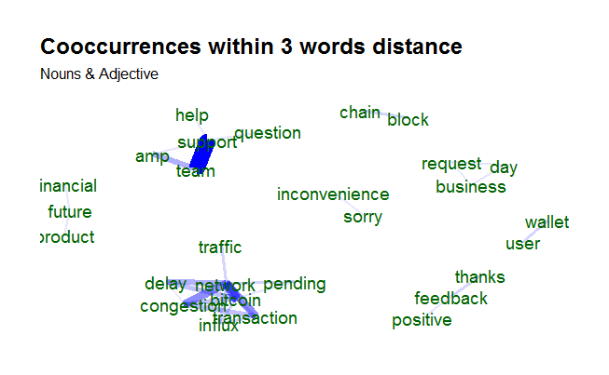
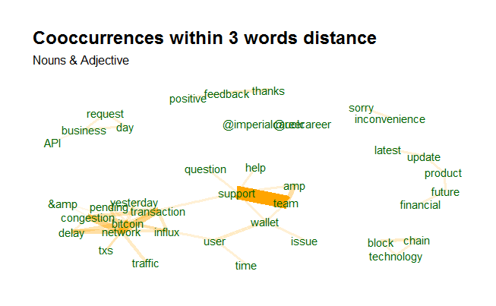
Cooccurrences between words for nouns and adjectives in Cryptocurrencies corpus.
Cooccurrences between words for nouns and adjectives in Blockchain
corpus.

Slide 29
Top 10 nouns in Cryptocurrencies
Top 10 nouns in Blockchain corpus
 | key <chr> | freq <int> | freq_pct <dbl>
1 | support | 32 | 4.134367
2 | team | 28 | 3.617571
3 | wallet | 23 | 2.971576
4 | network | 19 | 2.454780
5 | transaction | 18 | 2.325581
6 | bitcoin | 16 | 2.067183
7 | user | 16 | 2.067183
8 | thanks | 15 | 1.937984
9 | amp | 15 | 1.937984
10 | update | 10 | 1.291990
 | key <chr> | freq <int> | freq_pct <dbl>
1 | @tipprbot | 54 | 1.6922595
2 | team | 38 | 1.1908493
3 | support | 37 | 1.1595111
4 | transaction | 36 | 1.1281730
5 | network | 36 | 1.1281730
6 | people | 32 | 1.0028204
7 | wallet | 29 | 0.9088060
8 | day | 28 | 0.8774679
9 | user | 27 | 0.8461297
10 | money | 26 | 0.8147916

Slide 30
Most positive sentiment line in cryptocurrencies
Most negative sentiment line in cryptocurrencies.
Positive words in the Cryptocurrency corpus
[1] "@DewiPutri Hi Dewi! Please contact our support team so we can advise &amp; assist on this issue: aVTaYqufM Thank you."
[1] "@Rastachildd Hi there! When the network is congested, this can unfortunately result in delayed transactions."
[1] "secure" "worth" "like" "glad" "cool" [6] "improving" "magic" "work" "awesome" "works" [11] "trust" "fans" "available" "winners" "cashback" [16] "nice" "interesting" "valuable" "free" "reward" [21] "right" "innovation" "amazing" "encourage" "excellent" [26] "successfully" "upgraded" "popular" "balanced" "good" [31] "useful" "benefactor" "recovery" "sensitive" "easy" [36] "better" "win" "top" "benefits" "great" [41] "holy" "worked" "superior" "reliably" "support" [46] "wow" "excited" "enough" "smart" "perfectly"

Slide 31
Negative words in cryptocurrency corpus
[1] "warning" "failure" "useless" "worse" [5] "corrupt" "crash" "criminal" "set up" [9] "concerns" "lost" "miss" "inadequate" [13] "volatile" "limit" "irony" "confuse" [17] "accuse" "hedge" "lie" "hard" [21] "dangerous" "incorrectly" "delusions" "drawbacks" [25] "funny" "lack" "cripple" "choppy" [29] "slower" "cheap" "overwhelming" "self interest"[33] "lose" "harass" "fanatics" "punish" [37] "disagree" "steal" "crazy"
Hashtags in cryptocurrency corpus
crypto_hashtags
#cryptocurrency #blockchain #crypto #Blockchain #ICO
339 155 117 115 112
#bitcoin #ethereum #Crypto #Cryptocurrency #ico
110 84 83 71 45
#btc #Bitcoin #airdrop #bounty #ARAW
43 39 36 35 32
#Ethereum #tokensale #Airdrop #eth #ETH
32 30 26 24 24

Slide 32
Hashtags in Bitcoin corpus
[1] "list"
btc_hashtags
#bitcoin #Bitcoin #blockchain #cryptocurrency #crypto
212 145 118 106 103
#ethereum #ICO #Blockchain #Crypto #btc
85 74 49 43 36
#Airdrop #TokenSale #Ethereum #BTC #ether
35 34 33 30 23
#ico #ETH #finance #shopera #Cryptocurrency
23 18 17 17 16

Slide 33
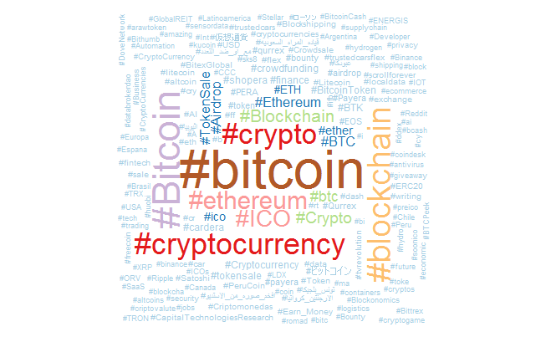
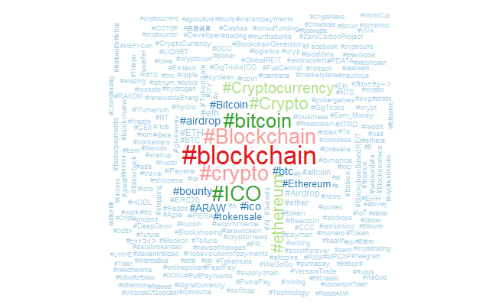
Comparison of live tweets of Cryptocurrency and Bitcoin

Slide 34
Most Joyful words occurred in corpus.
Most fearful words occurred in the corpus.
Word <chr> | n <int>
Cash | 75
Money | 29
Pay | 10
exciting | 9
excited | 7
Good | 7
Word | n
Cash | 75
lightning | 13
Watch | 13
Change | 7
government | 6
.

Slide 35
Words like sorry, hard, congestion, issue, attacks are occurring most in negative sentiments. Words like thank, right, welcome, cool, exciting, most of the words are sentiment words in cryptocurrency corpus.

Slide 36
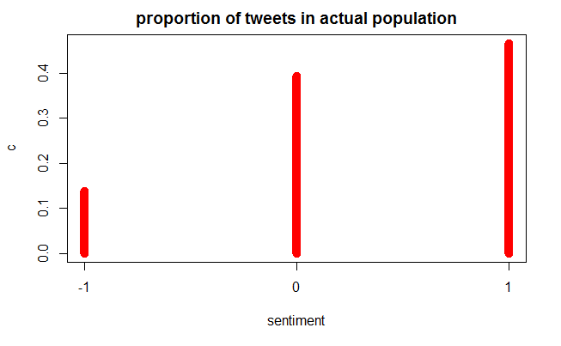
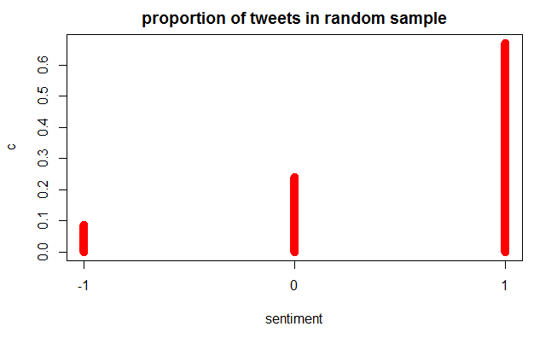
Comparison of predicted sentiments with actual population of sentiments of Bitcoin. Sentiments of Tweets of Bitcoin were taken as training data and sentiments of tweets of Cryptocurrency were predicted

Slide 37
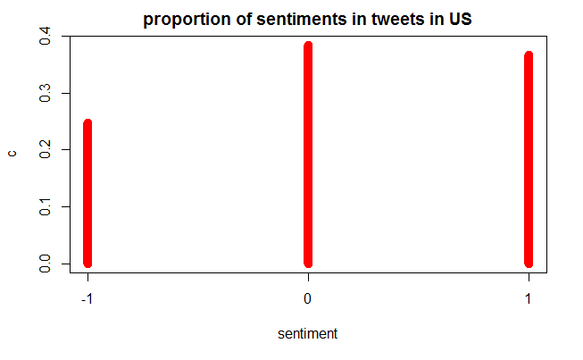
Regional wise analysis of Cryptocurrency
Proportion of sentiments of tweets of Bitcoin in US - Neutral and Positive tweets are almost equal. The negative tweets are 25% of the total tweets. The sentiment is diverse.

Slide 38
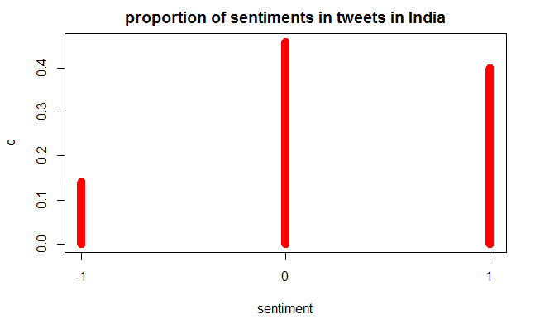
Most of the tweets are neutral, 45% of tweets, 40% are positive and 15% are negative.

Slide 39
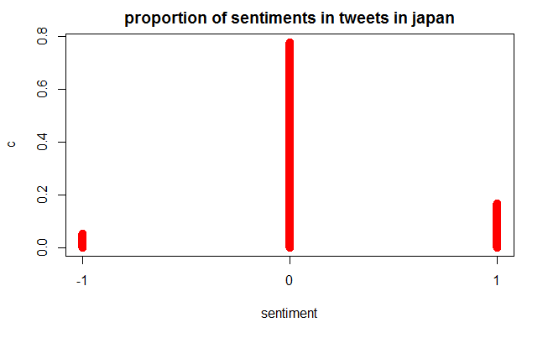
Most of the tweets are neutral in Japan. Most the users are having neutral sentiment of Bitcoin.

Slide 40
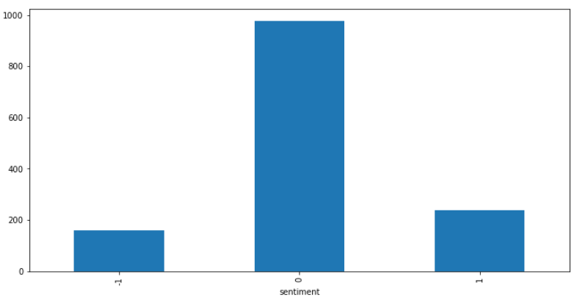
Sentiment Analysis of Investors, banks, regulators
Most of the tweets are neutral – 0, Positive and Negative are almost equal. Most the investors, banks are having neutral sentiment of Cryptocurrency.

Slide 41
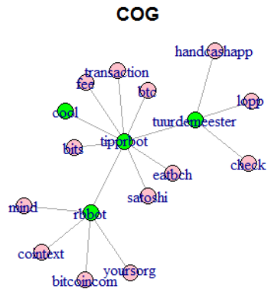
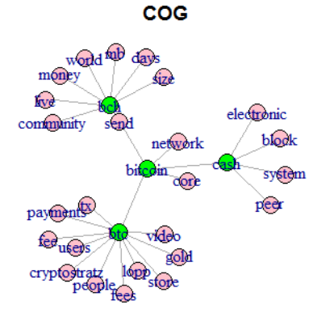
4 clusters of Cryptocurrency corpus

Slide 42
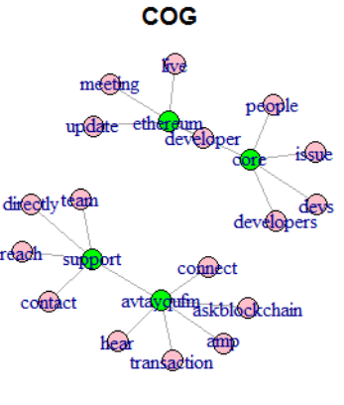
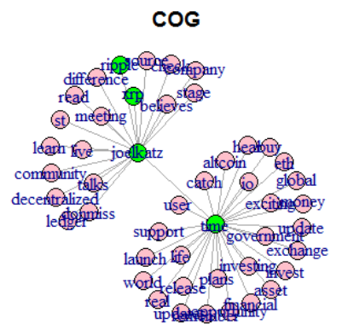

Slide 43
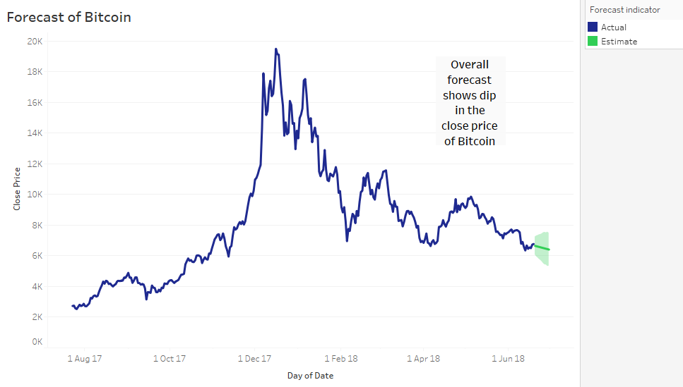

Slide 44
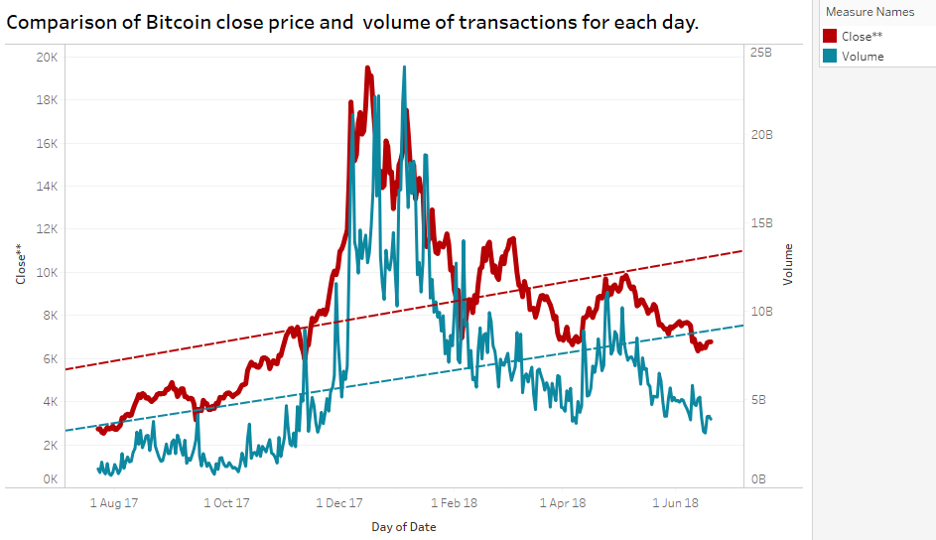
Trend line of Close price and trend line of volume of transactions for each day are positive for Bitcoin.

Slide 45
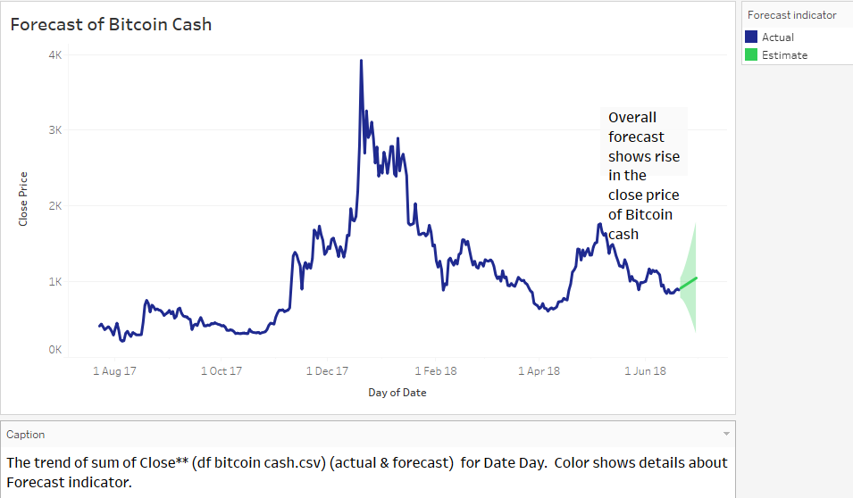

Slide 46
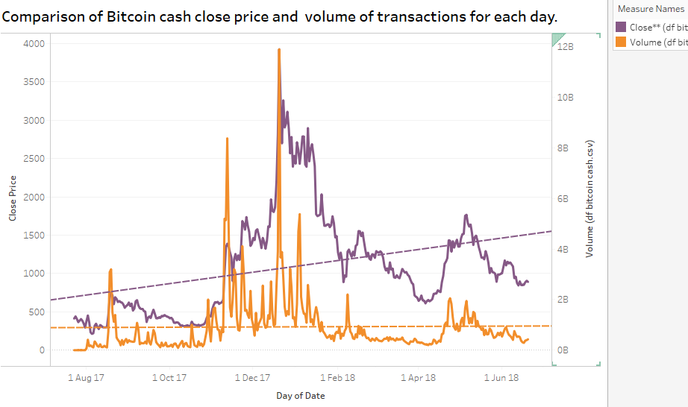
Trend line of Close price is positive as compared to trend line of volume of transactions for each day for Bitcoin Cash.

Slide 47
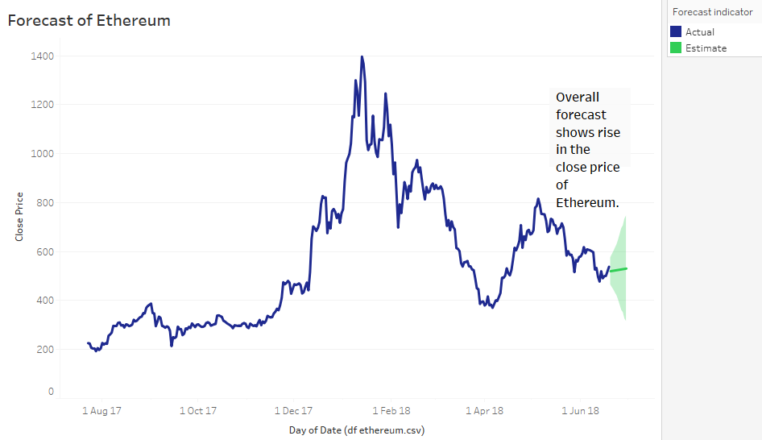

Slide 48
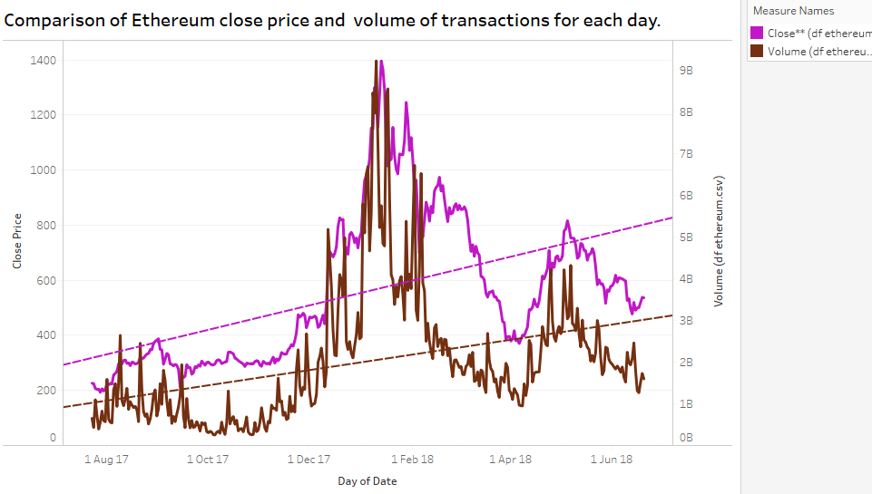
Trend line of Close price and trend line of volume of transactions for each day are positive for Ethereum.

Slide 49
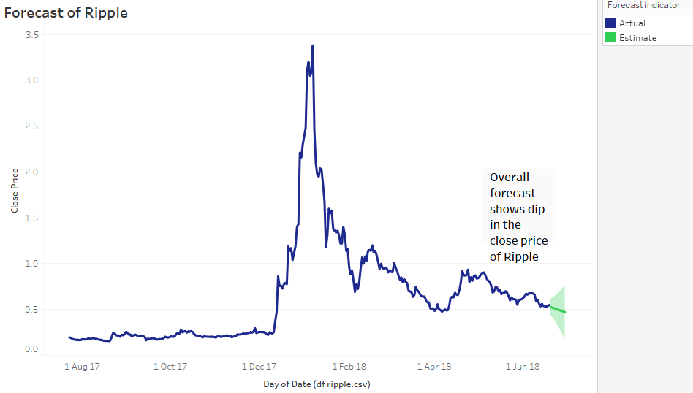

Slide 50
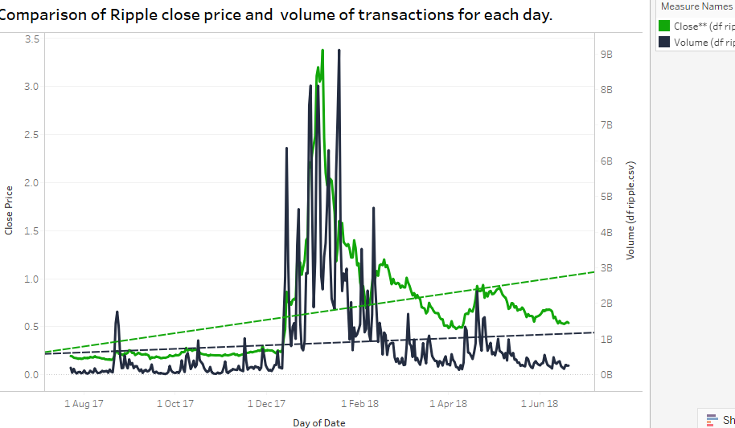
Trend line of Close price is positive as compared to trend line of volume of transactions for each day for ripple

Slide 51
Modelling, evaluation
Naïve Bayes model was selected for text classification and sentiment classification of tweets.
Maximum entropy model is chosen sentiment analysis.
Confusion matrix is used for evaluation.

Slide 52
Business Recommendation
Forecasting of cryptocurrency growth can be used to invest in the cryptocurrencies.
The decision to invest in a specific cryptocurrency can be used to gain maximum returns.
Bitcoin and other cryptocurrencies are related to Blockchain. Blockchain tweets can be used to analyse it.

Slide 53
Assumptions, Limitations:
Close prices of the cryptocurrencies are following normal distribution.
Variances of four cryptocurrencies are equal.
The data taken from sites, articles is correct and cleaned.
Not able to collect tweets of Bitcoin cash from twitter.
The sentiments can be related to growth of cryptocurrency for further work.

Slide 54
References
https://coinmarketcap.com/
https://economictimes.indiatimes.com/markets/stocks/news/cryptocurrencies-are-like-ponzi-schemes-world-bank-chief-says/articleshow/62830841.cms
https://economictimes.indiatimes.com/markets/stocks/news/how-cryptocurrencies-split-global-central-banks/articleshow/62715511.cms
https://economictimes.indiatimes.com/markets/stocks/news/anger-shock-confusion-as-rbi-bars-banks-from-cryptocurrencies/articleshow/63638799.cms
https://coinpupil.com/altcoins/advantages-disadvantages-of-cryptocurrency/
https://economictimes.indiatimes.com/wealth/invest/7-reasons-why-you-should-not-invest-in-bitcoins-cryptocurrencies/articleshow/60891341.cms
https://www.investinblockchain.com/7-signs-bad-cryptocurrency/
http://thecircular.org/cryptocurrencies-bad-sides-bitcoin/

